Slide 1
NetCDF Diag (stat) Files
Albert Huang
Will McCarty

Slide 2
So why now?
Too many if statements and shared fields
Can’t easily add things (IMO, no offense to the extra block)
I sure wish I could easily trigger something to write out the jacobians or easily dump diagnostics in development
Albert spent time trying to read diags last summer and realized they were, at best, problematic
I wrote a python reader and it was too slow to be worthwhile for large datasets (namely – hyperspectral IR)
There is the thought of being able to distribute observation feedbacks/statistics to the community
We could never distribute diags as anything official

Slide 3
Data Storing
How the diag is written
Header Block (variables/strings)
Chaninfo block
Metadata block (record-specific info, i.e. lat/lon)
Data block (datum-specific info, i.e. obs, departure)
Data storage under new netcdf interface will take a slight change in thought
Current radiance diags are record (e.g. footprint) based
Current conventionals are datum (e.g. single T ob) based

Slide 4
New NetCDF Files
Move to a datum-based approach for both radiances and conventional
Will result in redundant entries of metadata (each radiance will have a lat/lon)
Internal compression makes this a non-issue for disk space
Every observation (radiance or conventional) will have a ‘Record Locator’ akin to a VIN numer
I.e YYYYMMDDHHMMSS{inst_platform}
20150708150459airs_aqua
Since obs will likely be written in order by record, reconstruction to record space is pretty easy
NetCDF v4 is chosen
Simply, it’s the latest version
Even more simply, it’s what we use for our model fields so no new libraries were required for us
NC4 is an extension of HDF-5 (so HDF5 can read NetCDF 4 files)
Navy uses H5, so in theory, they could write their files in the same format if they wanted

Slide 5
nclayer!
Albert Huang
Summer 2015
SSAI/NASA GSFC for GMAO

Slide 6
Motivation
nclayer = NetCDF Layer
Data storage flexibility
Small to moderate overhead
Simple API
Read, write, manipulate
“Focus on your data, not on the format!”
Easier to use (in terms of data)
Python, IDL, etc…
Standardization

Slide 7
nclayer “collection”
nc_diag_write
nc_diag_cat
nc_diag_read
“Development order”
nc_diag_res
nc_diag_attr

Slide 8
nclayer “collection”
nc_diag_write
Data
Writing
nc_diag_cat
nc_diag_read
Data
Reading
nc_diag_res
Data
Selection
nc_diag_attr
Post-
Processing

Slide 9
nclayer “collection”
nc_diag_write
nc_diag_write
nc_diag_cat
Easy-to-use NetCDF writing layer library for data
No NetCDF “mess”
Accepts scalars and arrays, writes data
Linkable Fortran library
Main “goal” for this project
nc_diag_read
nc_diag_res
nc_diag_attr

Slide 10
nclayer “collection”
nc_diag_write
NetCDF primer:
Attributes store metadata about the file (global attributes) and about the variables (variable attributes)
They are flexible, can be added/deleted/changed after creation

Slide 11
nclayer “collection”
nc_diag_write
NetCDF primer:
Data can have fixed and unlimited dimensions
Fixed dimensions are finite – they are always defined as an integer
e.g. 4, 5, 8 (in dimensions, 4x5, 6x7)
Unlimited dimensions allow infinite data expansion
You CAN count the amount of data you have, but you are not limited by any dimension – you can keep adding data!
Variables can have many fixed dimensions, but only ONE unlimited dimension!

Slide 12
nclayer “collection”
nc_diag_write
NetCDF primer:
Variables can store data
Variables can be added and renamed.
However, variables CAN’T be redefined or deleted.
(You can’t change the dimensions of a variable, but you can still add more data!)

Slide 13
nclayer “collection”
nc_diag_write
NetCDF primer:
NetCDF-isms:
MUST keep track of special IDs for the file, variables, dimensions, etc…
You MUST know your dimensions and variables beforehand before you can write any data.
You CAN’T change anything after you are done defining said dimensions and variables!
That said, nc_diag_* aims to mitigate all of that!

Slide 14
nclayer “collection”
nc_diag_write
Coming up – our naming conventions, and what they mean!

Slide 15
nclayer “collection”
nc_diag_write
Header – the metadata to describe the data file being written
NetCDF-land: global attributes
Example: INSTRUMENT = airs_aqua
Chaninfo – channel information variables
Variables that describe each channel
Dimensions: 1 x nchans (fixed)
Example: what wavelength is the channel using?
Metadata – observation by observation metadata variables
Dimensions: 1 x nobs (unlimited)
Example: what channel is the observation recorded with?

Slide 16
nclayer “collection”
nc_diag_write
Data2d – 2D data variables for each observation
Dimensions:
VarX (fixed) x nobs (unlimited)
VarX dimension is specified to the variable
nobs is shared between metadata and data2d
They are linked!
Varattr – metadata about each variable
NetCDF-land: …variable attributes!
Example: variable “wind_speed” can have this varattr:
UNIT = “meters per second”

Slide 17
nclayer “collection”
nc_diag_write
Simple API:
call nc_diag_init(“mydata.nc”)
call nc_diag_header("header", 123)
call nc_diag_chaninfo_dim_set(10)
call nc_diag_chaninfo(“chaninfo”, 123)
call nc_diag_metadata("metadata”, 1.234)
call nc_diag_metadata("metadata”, 5.678)
call nc_diag_data2d("data2d”, (/ 1.2, 2.3, 3.4 /))
call nc_diag_data2d("data2d”, (/ 4.5, 6.7, 8.9 /))
call nc_diag_varattr(“metadata”, “myunit”, “m/s^2”)
call nc_diag_write

Slide 18
nclayer “collection”
nc_diag_write
“Advanced” API:
Buffering data (write out data, reset memory counter)
Definition locking for variable attributes
File appending
Various settings (string trimming, strictness, warnings/errors, etc.)

Slide 19
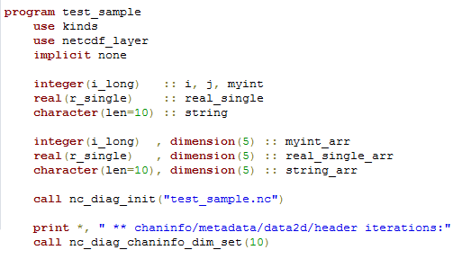
nclayer “collection”
nc_diag_write
Sample program:

Slide 20
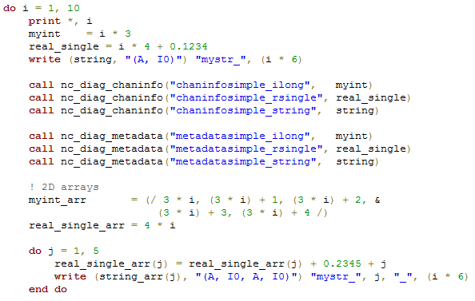
nclayer “collection”
nc_diag_write
Sample program:

Slide 21
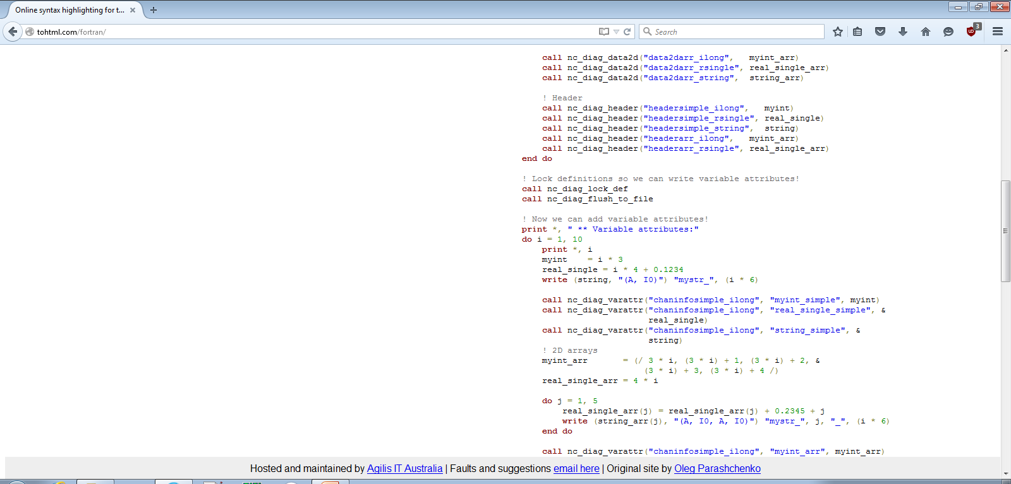
nclayer “collection”
nc_diag_write

Slide 22
nclayer “collection”
nc_diag_write

Slide 23
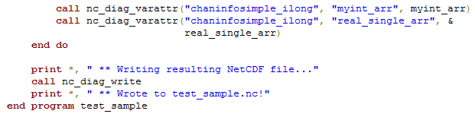
nclayer “collection”
nc_diag_write

Slide 24

nclayer “collection”
nc_diag

Slide 25
nclayer “collection”
nc_diag_cat
nc_diag_cat
Tool to concatenate many NetCDF files into one!
Fortran-based tool
Used only for nc_diag_write NetCDF output
MPI-enabled for faster reading/writing
Easy to use:
nc_diag_read
nc_diag_res
nc_diag_attr
./nc_diag_cat.x –o big_netcdf.nc small1.nc small2.nc …

Slide 26
nclayer “collection”
nc_diag_cat
Concatenation Methods:
Header:
header1,
header2,
header3,
…
header1,
header2,
header3,
…
header1,
header2,
header3,
…
File 1
Concatenated File
File 2
File 3

Slide 27
nclayer “collection”
nc_diag_cat
Concatenation Methods:
Varattr:
Variable attributes are NOT preserved
(Design decision due to speed + other tool availability)
varattr1,
varattr2,
varattr3,
…
varattr1,
varattr2,
varattr3,
…
varattr1,
varattr2,
varattr3,
…
File 1
Concatenated File
File 2
File 3
Variable: chaninfo1
Notes:
NOTE: There IS a way to try and make it efficient – via add_var() internally – if not exist, do attribute copy then… but it’s iffy since we need to define the variable first! So we need an attribute storage variable… ick.

Slide 28
nclayer “collection”
nc_diag_cat
Concatenation Methods:
Chaninfo:
ChanVar
chaninfo1,
chaninfo2,
chaninfo3,
…
ChanVar
chaninfo1,
chaninfo2,
chaninfo3,
…
ChanVar
chaninfo1,
chaninfo2,
chaninfo3,
…
File 1
Concatenated File
File 2
File 3

Slide 29
nclayer “collection”
nc_diag_cat
Concatenation Methods:
Metadata
Assume: nobs = 3
mdvar1
1
2
3
4
5
6
7
8
9
File 1
mdvar1
1
2
3
mdvar1
4
5
6
mdvar1
7
8
9
File 2
File 3
File 1
File 2
File 3
Concatenated File

Slide 30
nclayer “collection”
nc_diag_cat
Concatenation Methods:
Metadata
mdvar1
1
2
3
4
5
7
8
9
File 1
mdvar1
1
2
3
mdvar1
4
5
mdvar1
7
8
9
File 2
File 3
File 1
File 2
File 3
nobs = 3
nobs = 2
nobs = 3
Concatenated File

Slide 31
nclayer “collection”
nc_diag_cat
Concatenation Methods:
Metadata
mdvar1
1
2
3
7
8
9
File 1
mdvar1
1
2
3
mdvar1
7
8
9
File 2
File 3
File 1
File 2
File 3
nobs = 3
nobs = 3
nobs = 3
Concatenated File

Slide 32
nclayer “collection”
nc_diag_cat
Concatenation Methods:
Data2d
Assume: nobs = 3
d2dvar1
a | b | c
d | e | f
g | h | i
j | k | l
m | n | o
p | q | r
s | t | u
v | w | x
y | z | 1
File 1
d2dvar1
a | b | c
d | e | f
g | h | i
d2dvar1
j | k | l
m | n | o
p | q | r
d2dvar1
s | t | u
v | w | x
y | z | 1
File 2
File 3
File 1
File 2
File 3
Concatenated File

Slide 33
nclayer “collection”
nc_diag_cat
Concatenation Methods:
Data2d
Assume: nobs = 3
d2dvar1
a | b | c
d | e | f
g | h | i
j | k | l
m | n | o
s | t | u
v | w | x
y | z | 1
File 1
d2dvar1
a | b | c
d | e | f
g | h | i
d2dvar1
j | k | l
m | n | o
d2dvar1
s | t | u
v | w | x
y | z | 1
File 2
File 3
File 1
File 2
File 3
Concatenated File

Slide 34
nclayer “collection”
nc_diag_cat
Concatenation Methods:
Data2d
Assume: nobs = 3
d2dvar1
a | b | c
d | e | f
g | h | i
s | t | u
v | w | x
y | z | 1
File 1
d2dvar1
a | b | c
d | e | f
g | h | i
d2dvar1
s | t | u
v | w | x
y | z | 1
File 2
File 3
File 1
File 2
File 3
nobs = 3
nobs = 3
nobs = 3
Concatenated File

Slide 35

nclayer “collection”
nc_diag_cat

Slide 36
nclayer “collection”
nc_diag_read
Easy-to-use NetCDF reading library
Data agnostic – this can be used on any NetCDF file
Simple API:
If you’re feeling scared, you can also allocate yourself!
nc_diag_read
integer(i_long), dimension(:), allocatable :: var_stor
integer(i_long),dimension(:,:),allocatable :: var_stor_2d
call nc_diag_read_init("test.nc")
call nc_diag_read_get_var(“myvar”, var_stor)
call nc_diag_read_get_var(“myvar2d”, var_stor_2d)
call nc_diag_read_close
nc_diag_res
nc_diag_attr

Slide 37
nclayer “collection”
nc_diag_read

Slide 38
nclayer “collection”
nc_diag_read
Other “advanced” features:
Files: state-based open, push/pop open/close, independent ID open
Dimensions:
Check for existence
Fetch dimension data all at once (auto-alloc and normal alloc)
Variables:
Check and assert for existence
Fetch type, ndims and dimensions for a variable
Get all variable names
Get variable data all at once (auto-alloc and normal alloc)
Attributes (global AND variable):
Check and assert for existence
Fetch type and length of attribute
Fetch attribute data all at once (auto-alloc and normal alloc)

Slide 39
nclayer “collection”
nc_diag_res
Easy to use resource file “toggling” library
Linkable Fortran library
Simple API:
nc_diag_res
call nc_diag_load_resource_file("test_valid.json")
if (nc_diag_load_check_variable("myvar1")) print *, "myvar1“
if (nc_diag_load_check_variable("myvar2")) print *, "myvar2"
if (nc_diag_load_check_variable("myvar3")) print *, "myvar3"
call nc_diag_close_resource_file
nc_diag_attr

Slide 40
nclayer “collection”
nc_diag_res
JSON file:
{
"info" : {
"author" : "Albert Huang",
"description" : "This is a test resource file for bla bla bla.",
"timestamp" : "Wednesday, August 12th, 10:00 AM",
"organization" : "NASA"
},
"variables" : {
"myvar1" : true,
"myvar2" : false,
"myvar3" : true
}
}

Slide 41
nclayer “collection”
nc_diag_res
JSON file:
{
"variables" : {
"myvar1" : true,
"myvar2" : false,
"myvar3" : true
}
}
OUTPUT:
myvar1
myvar3
call nc_diag_load_resource_file("test_valid.json")
if (nc_diag_load_check_variable("myvar1")) print *, "myvar1“
if (nc_diag_load_check_variable("myvar2")) print *, "myvar2"
if (nc_diag_load_check_variable("myvar3")) print *, "myvar3"
call nc_diag_close_resource_file

Slide 42
nclayer “collection”
nc_diag_res
JSON file:
{
"variables" : {
"myvar1" : false,
"myvar2" : true,
"myvar3" : true
}
}
OUTPUT:
myvar2
myvar3
call nc_diag_load_resource_file("test_valid.json")
if (nc_diag_load_check_variable("myvar1")) print *, "myvar1“
if (nc_diag_load_check_variable("myvar2")) print *, "myvar2"
if (nc_diag_load_check_variable("myvar3")) print *, "myvar3"
call nc_diag_close_resource_file

Slide 43
nclayer “collection”
nc_diag_res
JSON file: (note that myvar2 is gone)
{
"variables" : {
"myvar1" : false,
"myvar3" : true
}
}
OUTPUT:
myvar3
call nc_diag_load_resource_file("test_valid.json")
if (nc_diag_load_check_variable("myvar1")) print *, "myvar1“
if (nc_diag_load_check_variable("myvar2")) print *, "myvar2"
if (nc_diag_load_check_variable("myvar3")) print *, "myvar3"
call nc_diag_close_resource_file

Slide 44
nclayer “collection”
nc_diag_attr
Tool to add variable and global attributes into NetCDF files via resource file!
Python based tool
Easy to use:
python ./nc_diag_attr.py -rc RESOURCE.json test1.nc test2.nc …
nc_diag_attr

Slide 45
nclayer “collection”
nc_diag_attr
More JSON:
{
"variables" : {
"myvar1" : true,
"myvar2" : false,
"myvar3" : true
},
"global_attributes" : {
"attr1" : 123,
"attr2" : 123.45,
"attr3" : "string here"
},
"variable_attributes" : {
"chaninfosimple_ibyte" : {
"hello_from_python" : "yay!",
"python_data" : 123,
"python_data_float" : 123.456
}
}
}
Note how we are
using the same
file for nc_diag_res

Slide 46
nclayer “collection”
nc_diag_attr
More JSON:
{
"global_attributes" : {
"attr1" : 123,
"attr2" : 123.45,
"attr3" : "string here"
},
"variable_attributes" : {
“test" : {
"hello_from_python" : "yay!",
"python_data" : 123,
"python_data_float" : 123.456
}
}
}
OUTPUT:
variables:
byte test (nchans) ;
…
test:hello_from_python = "yay!" ;
test:python_data = 123 ;
test:python_data_float = 123.456 ;
…
// global attributes:
…
:attr2 = 123.45 ;
:attr3 = "string here" ;
:attr1 = 123 ;
python ./nc_diag_attr.py -rc attr.json test1.nc
ncdump –h test1.nc | less

Slide 47
nclayer “collection”
nc_diag_attr
More JSON: (note effect of non-existent vars)
OUTPUT:
variables:
byte test (nchans) ;
…
…
// global attributes:
…
:attr1 = 123 ;
{
"global_attributes" : {
"attr1" : 123,
},
"variable_attributes" : {
“asdf" : {
"hello_from_python" : "yay!",
"python_data" : 123,
"python_data_float" : 123.456
}
}
}
python ./nc_diag_attr.py -rc attr.json test1.nc
ncdump –h test1.nc | less

Slide 48
nclayer applied!
nc_diag_write
data
selected
with
nc_diag_res
GSI
Writing
output
concat’d
with
nc_diag_cat
nc_diag_attr
Post-
Processing
nc_diag_read
Data
Reading

Slide 49
nclayer status
Most (if not all) code is done, but…
Buggy!
Still being testing and integrated
Very alpha stage
For the daredevils:
https://github.com/alberthdev/nclayer/tree/testing/crazywip

Slide 50
The end!
Just a rough overview of nclayer – more to come!

Slide 51
Diag writing
Old:
Open(4, file=filename)
diagbuf(1) = cenlat
…
if((lcw4crtm .and. sea) .or. tmi .or. gmi) then
diagbuf(23) = clw_guess_retrieval
else
diagbuf(23) = surface(1)%snow_depth ! snow depth
endif
…
do i=1,nchanl_diag
diagbufchan(1,i)=tb_obs(ich_diag(i))
…
Enddo
write(4) diagbuf,diagbufchan

Slide 52
NetCDF Diag Writing
New:
call nc_diag_init(diag_rad_file)
do i=1,nchanl_diag
call nc_diag_metadata("Latitude", cenlat)
call nc_diag_metadata("Snow_Depth",surface(1)%snow_depth)
call nc_diag_metadata("clw_guess_retrieval", clw_guess_retrieval)
call nc_diag_metadata("Observation", tb_obs(ich_diag(i)) )
Enddo
call nc_diag_write

Slide 53
NetCDF Diag Writing
Will write nproc diag files for radiances
Will write nproc x n-type (e.g. gps, t, uv) for conventional
Splitting conventional files up further at the nproc-level
Files will be concatenated in similar manner as current binary files

Slide 54
Implementation progress
GSI Writing:
Writing is being implemented in several setup routines
T, uv, gps, rad
Being driven by a gsiparm.anl logical switch
Reading:
Fortran subroutines (read_radiag_*) has been updated to invisibly read netcdf files (no change major to user)
Still need to consider conventional reader
Need to consider reading in GSI (observer) and EnKF, also would prefer to break heritage postprocessing as little as possible
Will hopefully result in readers in python, idl, fortran, etc. that don’t break when something new is added

Slide 55

Worries
Need buy-in
this won’t succeed without commitment

